Slide 1

EXCEL STATISTICS FOR BUSINESS ANALYTICS

Slide 2

George Mount
Data Analyst & Educator at Stringfest Analytics
George works as an independent analyst and data analytics educator with the goal to help clients manage their data so they think more creatively. He serves as a technical expert and lead curriculum developer for Thinkful’s data analytics program and is the instructor of the DataCamp course “Survey and Measure Development in R.”
George blogs about data, innovation, and career development at georgejmount.com. He holds a master’s degree in information systems with a certificate of achievement in quantitative methods from Case Western Reserve University

Slide 3

OBJECTIVES FOR TODAY
Explore a dataset for research questions
Check assumptions and build hypotheses
Test formally for a difference in means between two groups
Make compelling business recommendations using inferential statistics
Excel Statistics for Business Analytics

Slide 4

WHY WOULD WE DO THIS IN EXCEL?
“You get to look at the data every step of the way, building confidence while learning the tricks of the trade.”
-- John Foreman
Excel Statistics for Business Analytics

Slide 5
1. EXPLORATORY DATA ANALYSIS IN EXCEL

Slide 6


What the hey is EDA?
Preliminary understanding of variables
Classify them
Summarize them
Visualize them
Check assumptions before using them
YOU
YOUR DATA

Slide 7
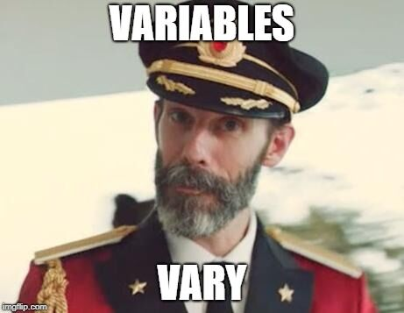
What is a variable?
Classical statistics: at least a 90%/10% split

Slide 8

VARIABLE TYPES AS RECIPE INGREDIENTS

Slide 9
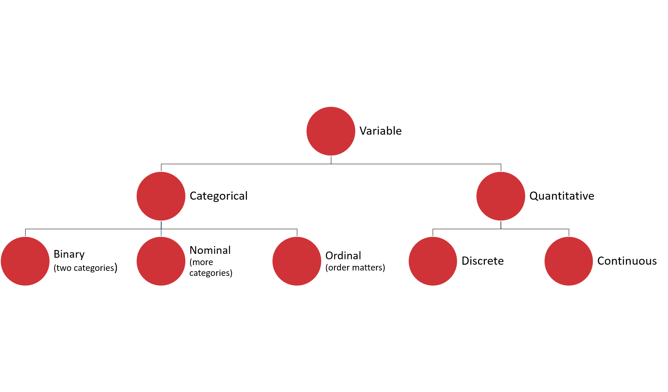

Slide 10
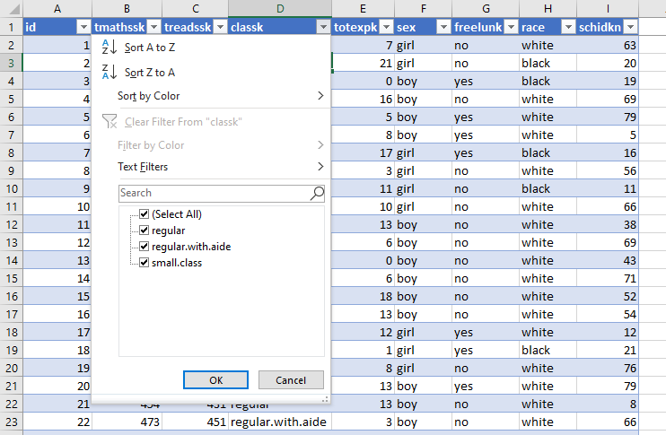
DRILLS
Dataset: wages.xlsx
What type is each variable?
(Don’t be afraid to poke at the data!)
Variable | Description | Type?
tmathssk | Total math scaled score
treadssk | Total reading scaled score
classk | Type of class
totexpk | Years of total teaching experience
sex | Sex
freelunk | Qualified for free lunch?
race | Race
schidkn | School indicator

Slide 11
DRILLS
Dataset: wages.xlsx
What type is each variable?
(Don’t be afraid to poke at the data!)
Variable | Description | Type?
tmathssk | Total math scaled score | Continuous
treadssk | Total reading scaled score | Continuous
classk | Type of class | Nominal
totexpk | Years of total teaching experience | Discrete
sex | Sex | Binary
freelunk | Qualified for free lunch? | Binary
race | Race | Nominal
schidkn | School indicator | Nominal

Slide 12

WHO KNOWS?
VARIABLE TYPES ARE CONTEXTUAL
IT’S NEBULOSE…

Slide 13
What the hey is EDA?
Preliminary understanding of variables
Classify them
Summarize them
Frequencies
Descriptive statistics
Visualize them
Check assumptions before using them
YOU
YOUR DATA

Slide 14
Summarizing a variable: frequencies
Used for categorical variables
How many of each value do we have? (Counts)
Use PivotTables
Demo: wages.xlsx

Slide 15
Summarizing a variable: descriptive statistics
Descriptive statistics
Used for continuous variables
Central tendency: what value is the variable centered around?
Mean: “average”
Median: “middle”
Mode: “most common”

Slide 16
DRILL
You are consulting for a non-profit on fundraising strategies
Donation data is shown to the right
Which measure of central tendency (mean/median/mode) should be tracked?
Variable
10
10
20
30
100

Slide 17
DRILL
You are consulting for a non-profit on fundraising strategies
Donation data is shown to the right
Which measure of central tendency (mean/median/mode) should be tracked?
No one statistic rules them all
Variable
$10
$10
$20
$30
$100
Statistic | Value
Mean | $34
Median | $20
Mode | $10

Slide 18
Summarizing a variable: descriptive statistics
Variability: how spread is the variable from the center?
Range: What are the min/max?
Variance: Relative to the mean, how far away does the data fall?
Standard deviation: Square root of the variance

Slide 19
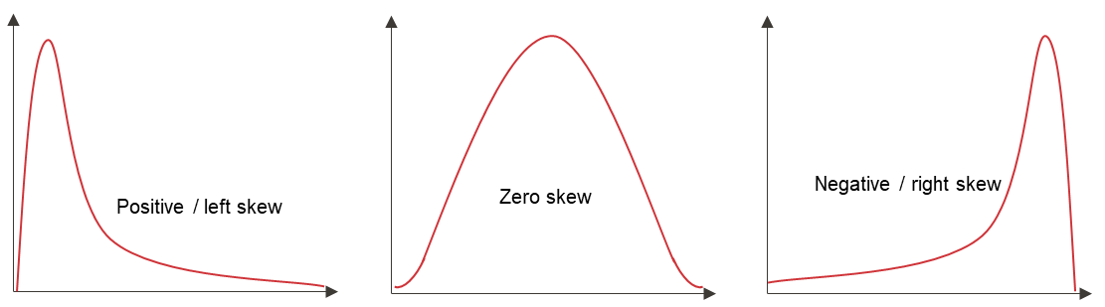
Summarizing a variable: descriptive statistics
Distribution: How is the data distributed?
Skewness: How lopsided is the data?

Slide 20
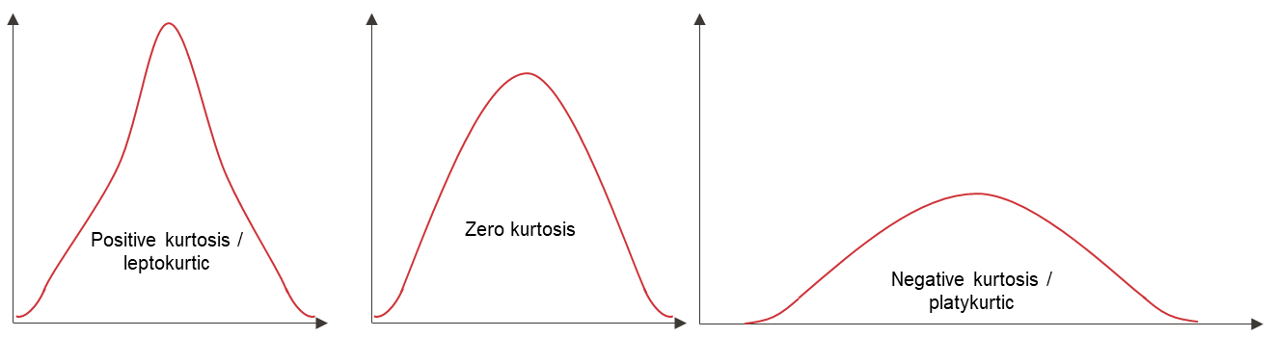
Summarizing a variable: descriptive statistics
Distribution: How is the data distributed?
Kurtosis: How jagged is the data?

Slide 21
Summarizing a variable: visualization
Histogram
What does the data’s distribution “looks like?”
How many data points lie with each bin?

Slide 22

STATROULETTE
A roulette wheel returns values between 0 and 36.
Let’s simulate a game of roulette in Excel

Slide 23
DRILL
Simulate 500 rounds of a roulette toss using RANDBETWEEN(0,36)
Plot the resulting frequency distribution
Hit F9 while in your workbook. What happens?

Slide 24
2. FOUNDATIONS OF INFERENTIAL STATISTICS

Slide 25
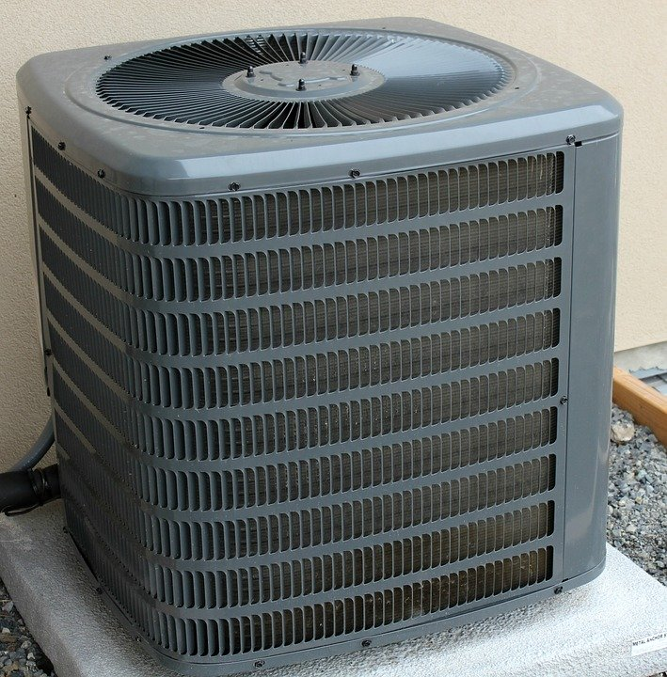
HOUSES WITH AIR CONDITIONING ARE BETTER THAN THOSE WITHOUT

Slide 26
HOUSES WITH AIR CONDITIONING ARE BETTER HAVE HIGHER VALUES THAN THOSE WITHOUT

Slide 27
HOUSES WITH AIR CONDITIONING ARE BETTER HAVE HIGHER VALUES THAN THOSE WITHOUT, ON AVERAGE

Slide 28

DEMO
File: housing.xlsx
Is there a difference in sales price for homes with air conditioning (airco)?

Slide 29

DRILL
File: housing.xlsx
Is there a difference in sales price for homes with a full, finished basement (fullbase)?
Save your work – you’ll “build on” it later!
Notes:
Photo source: https://unsplash.com/photos/T-br3SYp9kw
“Build on” is a pun :P

Slide 30

We have the data… just not all of the data
There is a difference across 546 homes…
… but what about all homes?
Is our sample reflective of their populations?
Notes:
https://unsplash.com/photos/iuqxv7kFj64

Slide 31

… but that doesn’t stop your phlebotomist!
Or your pollster
Or your QA manager
Or your real estate analyst 😉
Notes:
https://pixabay.com/photos/laboratory-analysis-diagnostics-2815639/

Slide 32

GETTING RIGOROUS WITH A HYPOTHESIS
Testable
Falsifiable
Burden of proof on the claimant

Slide 33
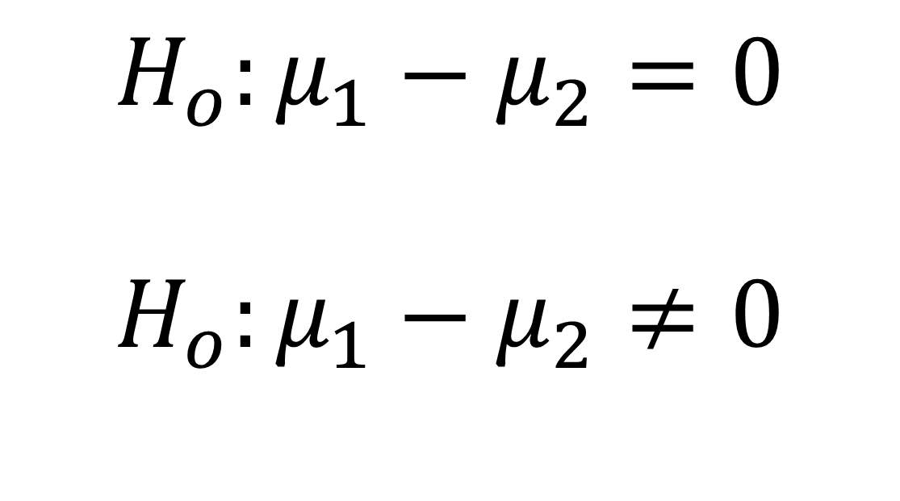
GETTING RIGOROUS WITH A HYPOTHESIS
No difference in population means
$$H_{o}:μ_{1}−μ_{2}=0$$
$$H_{o}:μ_{1}−μ_{2}≠0$$
Some difference in population means

Slide 34
… but we don’t know the population means…
Central limit theorem to the rescue!
Infer the population mean (which is normally distributed) given a sample mean…
... Some uncertainty required.
Usually 5%
Notes:
https://pixabay.com/photos/laboratory-analysis-diagnostics-2815639/

Slide 35
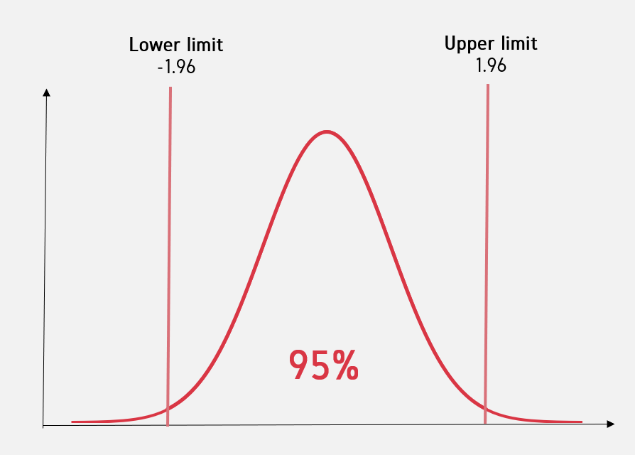
Critical value

Slide 36
EXPLICIT WARNING:
MATH AHEAD

Slide 37
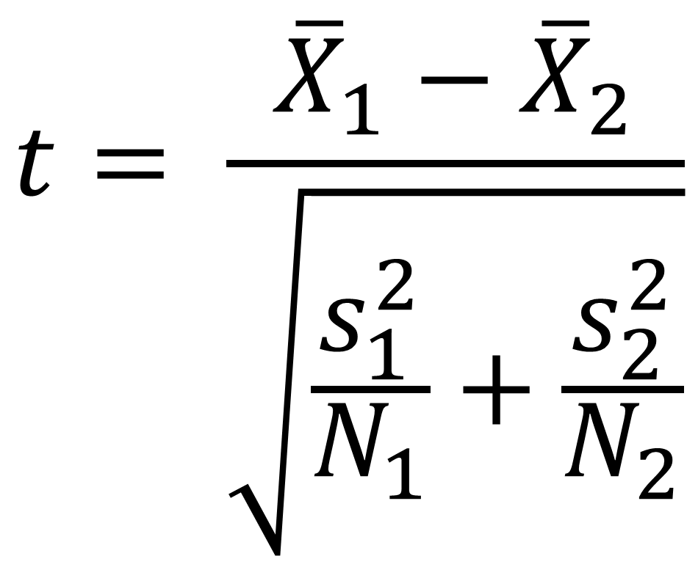
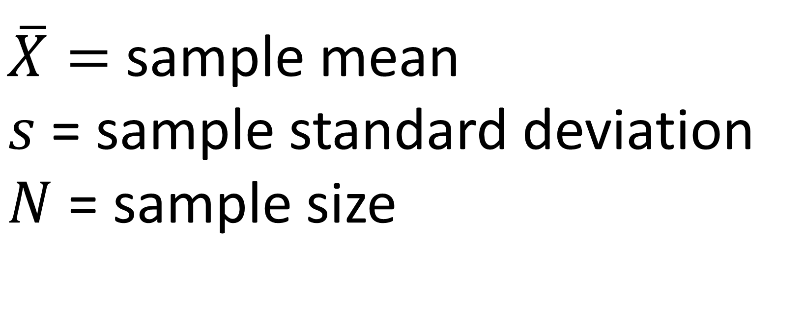
Calculating the test statistic
$$t= \frac{{\overline{X}}_{1}−{\overline{X}}_{2}}{\sqrt{\frac{s_{1}^{2}}{N_{1}}+\frac{s_{2}^{2}}{N_{2}}}}$$
$\overline{X}=$ sample mean
$s$ = sample standard deviation
$N$ = sample size

Slide 38
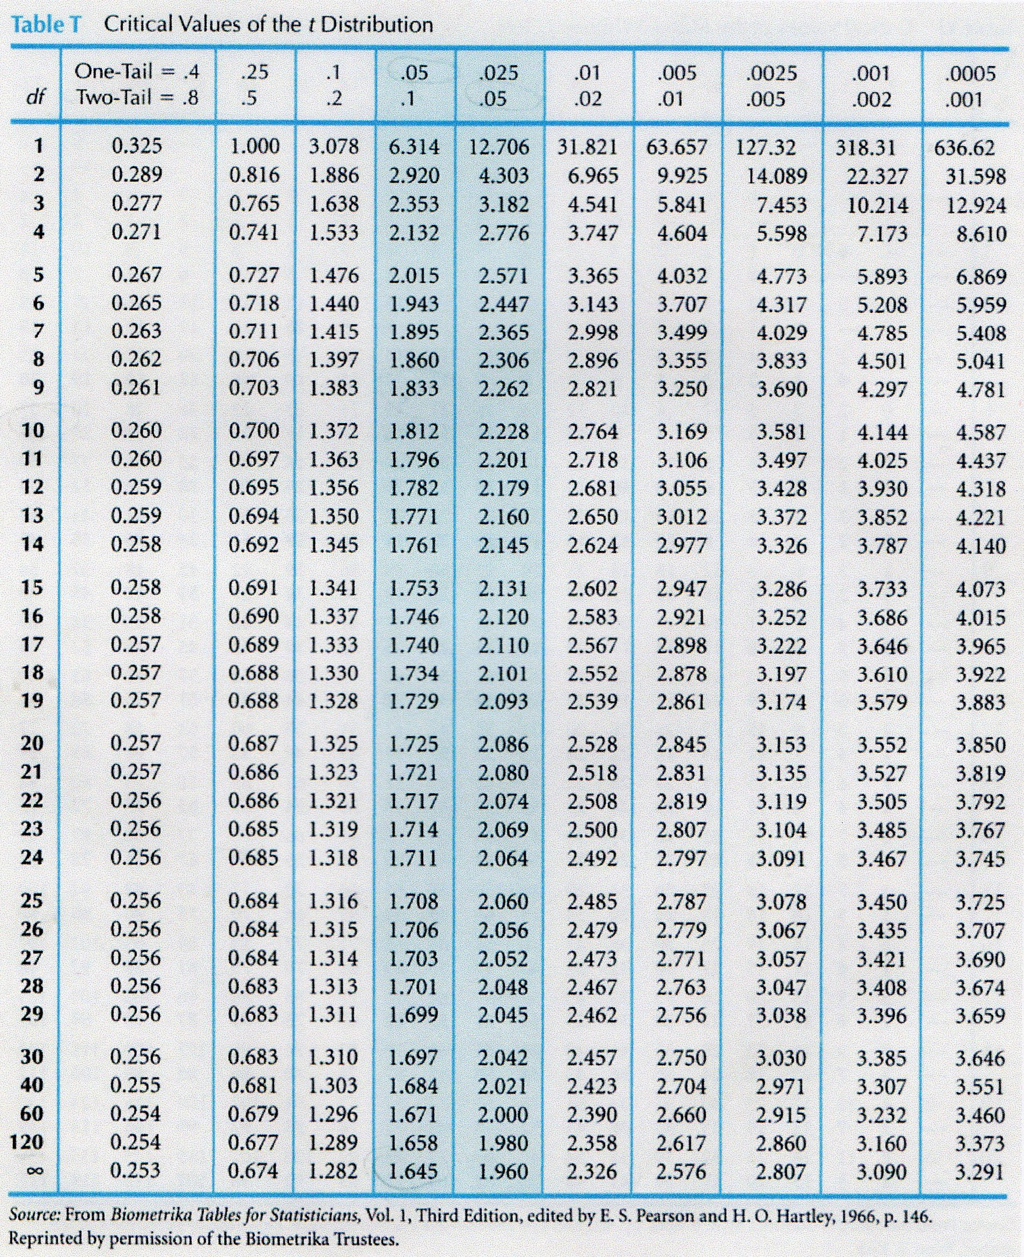
For every test statistic, a p-value
Notes:
We will get more into depth about how to interpret this p-value later.
A confidence interval is a range of population values with which the sample data are compatible. A significance test considers the likelihood that the sample data has come from a particular hypothesised population.

Slide 39
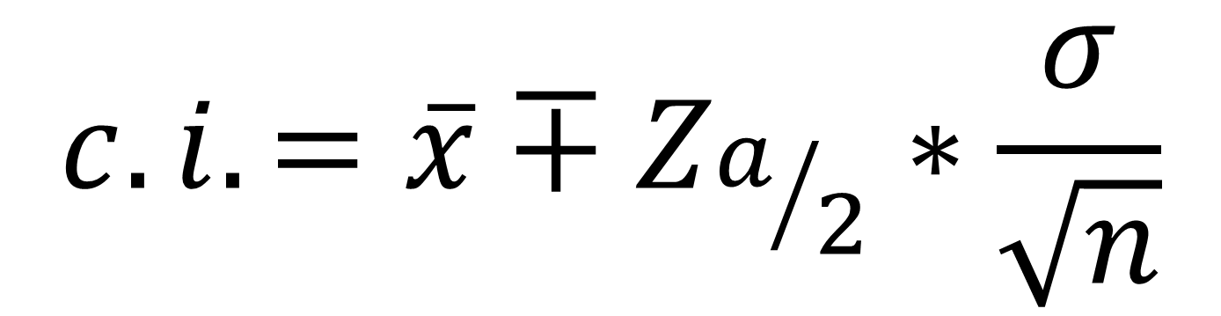
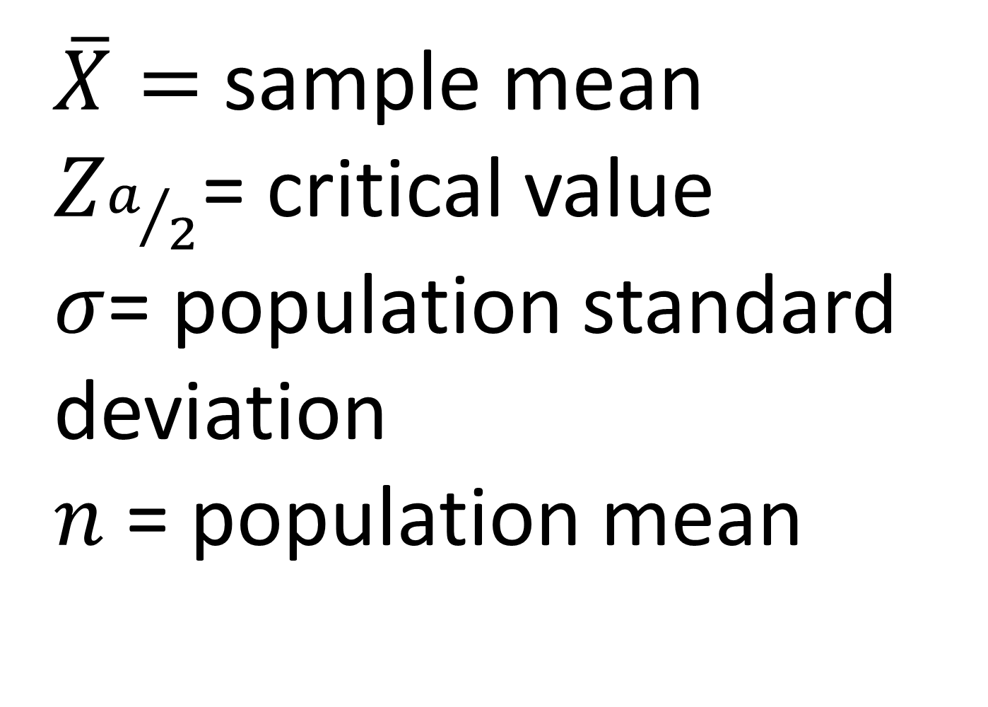
Calculating the confidence interval
$$c.i.=\overline{x}∓Z_{a/2}∗\frac{σ}{\sqrt{n}}$$
$\overline{X}=$ sample mean
$Z_{a/2}$= critical value
$σ$= population standard deviation
$n$ = population mean
1. Point estimate
2. Standard error
3. Margin of error

Slide 40
Calculating the confidence interval

Slide 41
3. T-TESTS FOR BUSINESS IMPACT

Slide 42
DRILL
File:

Slide 43
Frequencies
CASE
WHEN condition THEN result-expression
WHEN condition THEN result-expression ...
ELSE result-expression
END AS alias

Slide 44
Learning SQL, 2nd Edition
by Alan Beaulieu
Human Centered Design • MDLS 2020

Slide 45

MEET YOUR LIBRARIAN, SQL
STRUCTURED
QUERY
LANGUAGE

Slide 46
Common table expressions (CTEs):
Expressions acting like tables
WITH
expression_name_1 AS
(CTE query definition 1)
SELECT expression_A, expression_B, ...
FROM expression_name_1

Slide 47

Learning SQL, 2nd Edition
by Alan Beaulieu
•ON O’REILLY LEARNING AT HTTPS://WWW.OREILLY.COM/LIBRARY/VIEW/LEARNING-SQL-2ND/9780596801847/
Human Centered Design • MDLS 2020

Slide 48
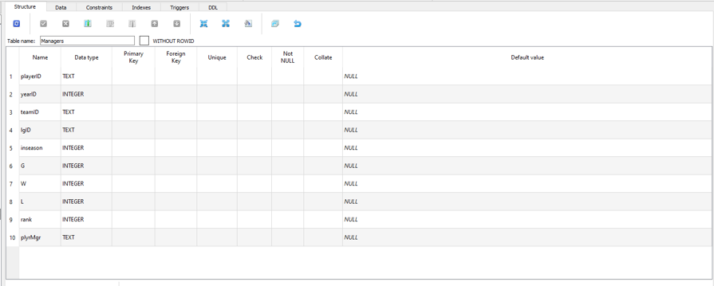
HOW MANY COLUMNS ARE IN MANAGERS?

Slide 49
HOW MANY COLUMNS ARE IN MANAGERS?

Slide 50
THE SQL READER'S DIGEST
CLAUSE
WHAT IT SETS
SELECT
Which fields to look for
FROM
Where to look for those fields
WHERE
What criteria records should meet
GROUP BY
How to aggregate the results
HAVING
What criteria the aggregated results should meet
ORDER BY
How to sort the results
LIMIT
How many records to limit results to

Slide 51

AND NOW YOU'LL NEVER FORGET
SWEATY
SELECT
FEET
FROM
WILL
WHERE
GIVE
GROUP BY
HORRIBLE
HAVING
ODORS
ORDER BY

Slide 52
LET'S TALK!
LINKEDIN
linkedin.com/in/gjmount
PHONE NUMBER
440-879-8399
EMAIL ADDRESS
george@stringfestanalytics.com
WEBSITE
stringfestanalytics.com

